Slide 1

Brain Tumor Detection Using Deep Learning
By Abhijeet Gupta and Yash Yadav

Slide 2
Introduction
Every year, around 11,700 people are diagnosed with a brain tumor
The ability to detect a tumor earlier when it is smaller reduces the impact of surgery and treatment
It improves the prognosis for many patients.
Objective - to explore the development of a deep-learning model for brain tumor detection using MRI scans.

Slide 3
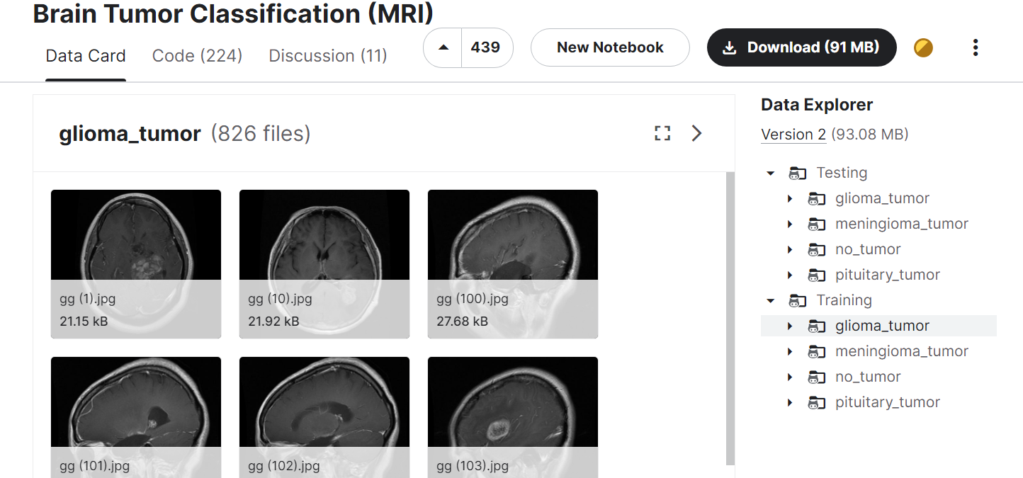
Methodology - Data collection
Kaggle
Pre-assigned training and testing data of 2870 and 394 images respectively.

Slide 4
Methodology - Data pre-processing
Convert the 4 target labels into binary classes -
“Yes” for glioma, meningioma, pituitary
“No” for no tumor
Use OpenCV
Scale images to a standard size of 256 x 256
Color conversion from RGB to Grayscale
Normalize image pixel values
Divide by 255
Range of 0 to 1
Conversions
Target classes from text to numeric format
Image dimension reshape

Slide 5
Methodology - Model creation
Convolutional Neural Network (CNN) from scratch using Keras
Layers
Input – takes images of dimension (256,256,1)
Hidden – 5 layers with Conv2D (ReLU), MaxPool2D, Dropout (0.1), Batch Normalization
Output – Flatten 2D to 1D -> 2 Dense Layers, with last one using Sigmoid activation for 2 output neurons (“Yes” and “No” tumor) probability prediction

Slide 6
Methodology - Model execution
Optimizer = adam
Loss = binary_crossentropy
Metrics = binary_accuracy
Early Stopping
Fit – 1000 epochs

Slide 7
Evaluation Metrics
Loss - binary cross entropy
Binary accuracy
Precision
Recall
F1-Score
Latter 3 are because of class imbalance - 14% are “No” and 86% are “Yes”

Slide 8
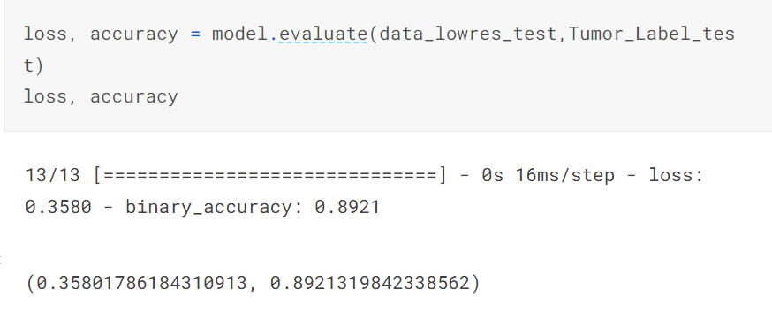
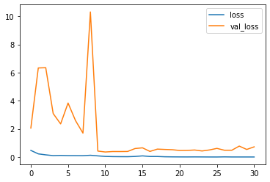
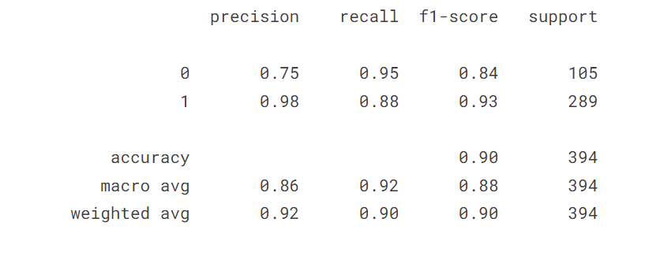
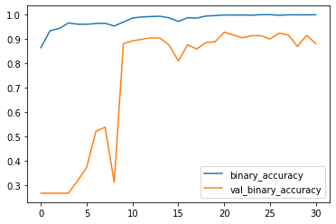
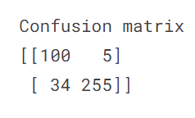
Results

Slide 9
Conclusion
Achievements
Accuracy of 89%
F1-Score on Tumor Positive Class of 93%.
Challenges
Model could be improved further by reducing False Negatives (34 out of 394 i.e., ~9%)
Can be dangerous as this means cancer patients are classified as non-cancerous
Model not interpretable since it’s NN
Future Scope
larger datasets – medical institute approval, data augmentation
Transfer Learning
Create an API in which images outside of Kaggle hosted dataset can be uploaded for tumour classification

Slide 10
How to use it (Reproducibility)
https://www.kaggle.com/code/abhijeetgupta23/brain-tumor-detection-using-cnn-larger-dataset
Create a Kaggle account
Phone verification is recommended so that Kaggle grants access to use GPU (P100) to run this code.
Kaggle Cloud hosted platform – no need to download image dataset and install python libraries
If not comfortable with Kaggle, you can use the provided zip file to run the .ipynb file containing code including CNN

